Slide 1
Forecasting Chicago
Home Prices
Time Series Analysis and Forecasting
University of Chicago
December 11, 2020

Slide 2
Agenda
EDA
Future steps
Introduction
Modeling and Results

Slide 3
Introduction
Real estate prices are of great interest to current and prospective property owners, lenders and government.
Understanding evolving trends in price is extremely valuable, especially in a competitive, yet highly seasonal market like Chicago.
In this project, we forecast median home sale prices in the City of Chicago.

Slide 4
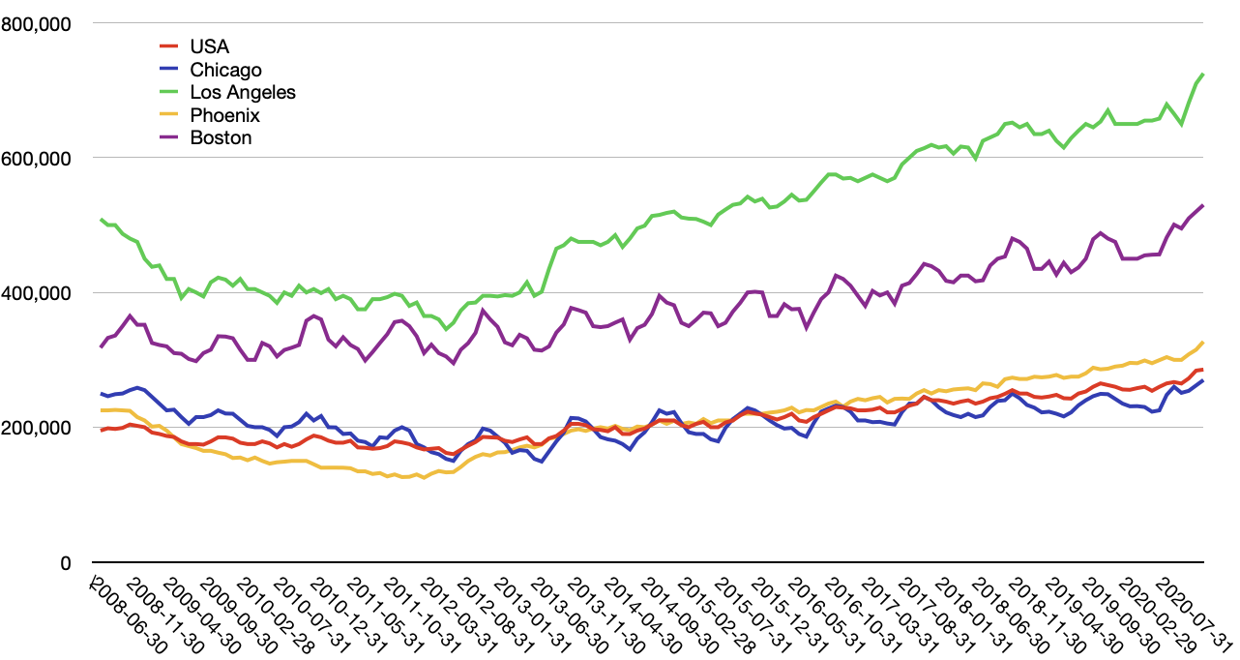
Chicago vs US cities
Like other cities with cold-climates, Chicago shows significant seasonal volatility.

Slide 5




Data Sources
Zillow (primary)
Feb 2008 – Jan 2020
139 observations
Complete
Mortgage Rate?
Google Trends
“Homes for Sale”, “Realtor”
Feb 2008 – Jan 2020
139 observations
Complete
CPI?

Slide 6
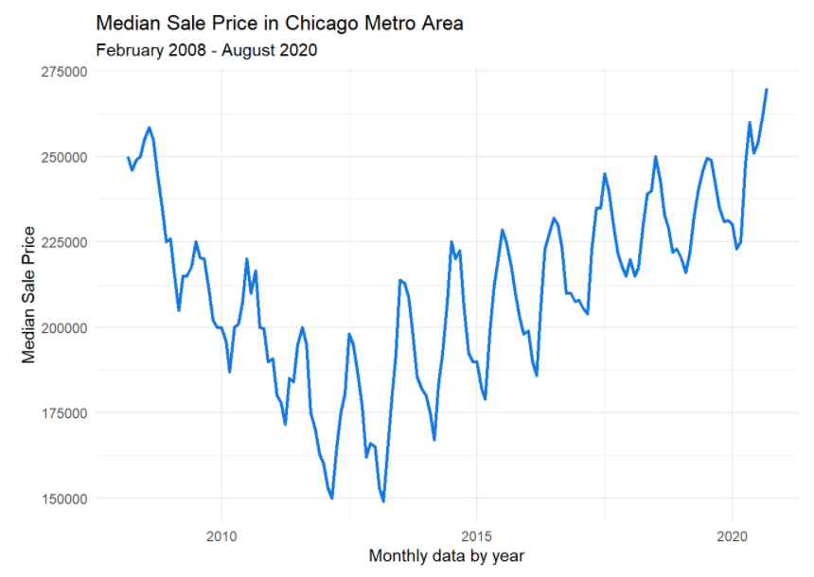
Exploratory Data Analysis
Notes:
Non-stationary
Unusual high seasonality
Two trends – down and up
The same magnitude

Slide 7
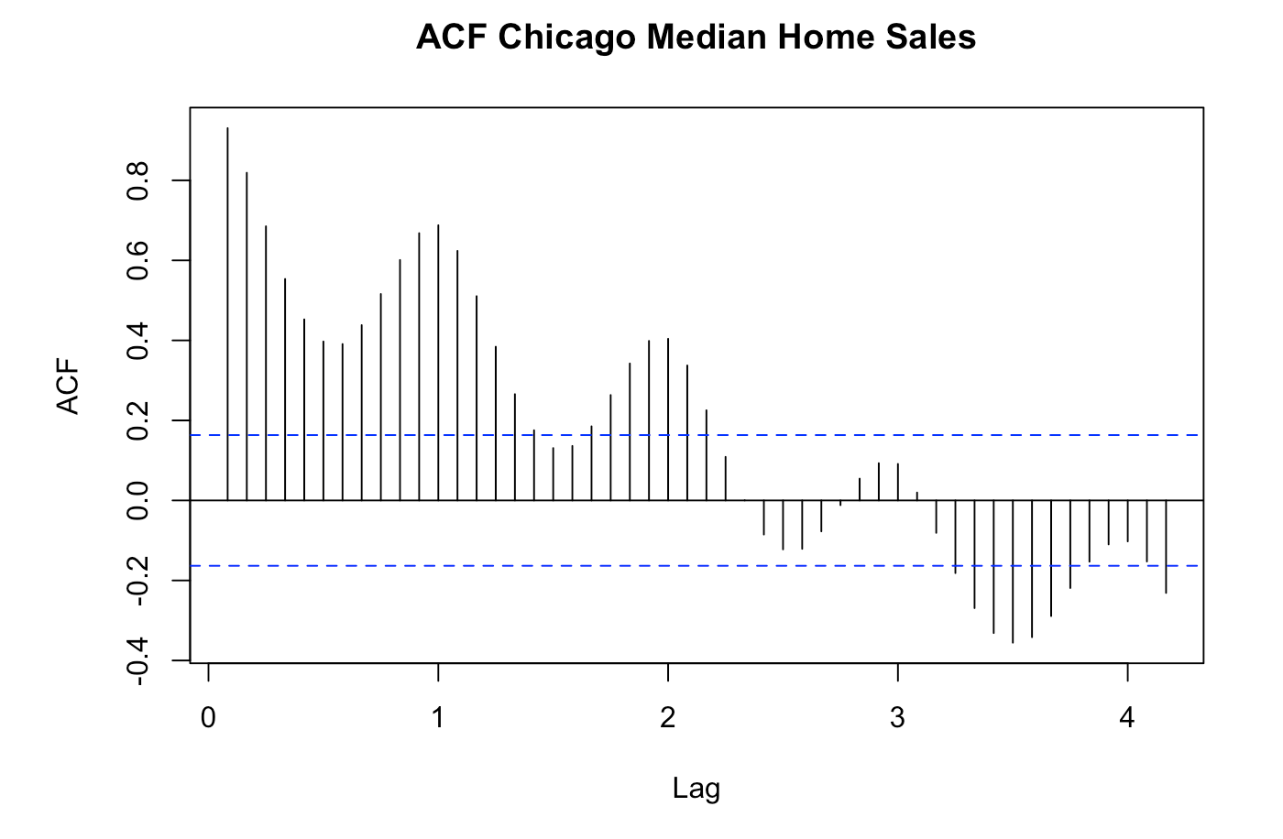
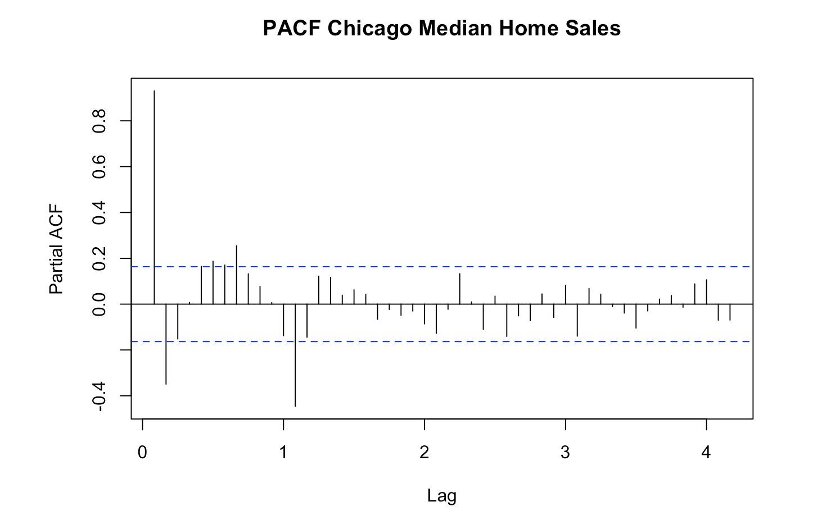
ACF & PACF

Slide 8
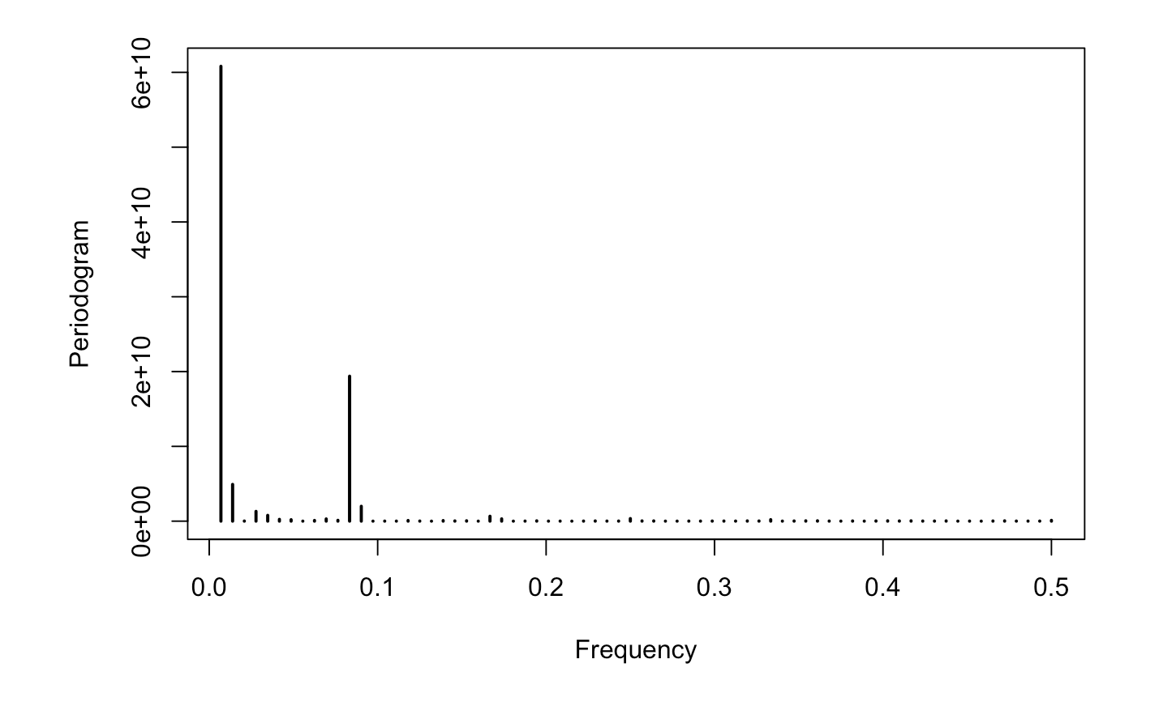
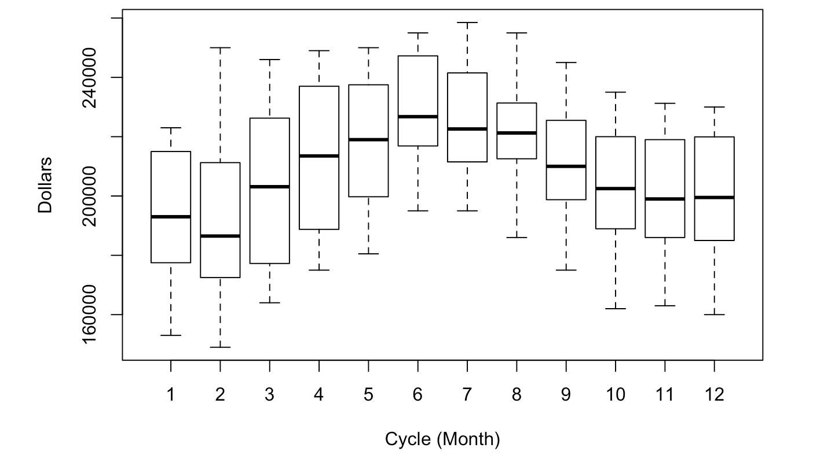
Seasonality

Slide 9
Model Selection
Model | Reason
Exponential Smoothing
sArima
Regression with ARMA errors
VAR
Dynamic Harmonic Regression
Prophet

Slide 10
Specifics about each model...
Notes:
https://www.cnn.com/2020/07/28/business/starbucks-earnings-coronavirus/index.html

Slide 11
Model Performance
Notes:
https://www.cnn.com/2020/07/28/business/starbucks-earnings-coronavirus/index.html

Slide 12
Next Steps
Notes:
https://www.cnn.com/2020/07/28/business/starbucks-earnings-coronavirus/index.html

Slide 13
Sources
GitHub repository

Slide 14




Our Team
Chris Reimann
Kyla Ronellenfitsch​
Oleksiy Anokhin​
Mike Thompson

Slide 15
Q & A

